Slide 1

AB InBev Strategic Market Analysis on the Impact of MicroBreweries to Market Share
By: Team DataTex

Slide 2
Introduction
As of 2015 AB InBev has a 45.8% share of the US Beer market
Worldwide market shares for InBev have been steadily increasing.
Argentina 76.7%
Brazil 67.5%
South Korea 57.0%
Mexico 58.2%
Belgium 55.5
Merger with Anheuser-Busch has made AB InBEV the largest brewer in America
Overall Beer Consumption up from prior year.
US market share down 1.7% when compared to 2014 data.
This may be due to the impact of MicroBreweries and changes in US beer preference.
https://www.statista.com/statistics/199024/ab-inbev-beer-market-share-by-country/
Notes:
Argentina 76.7%,

Slide 3
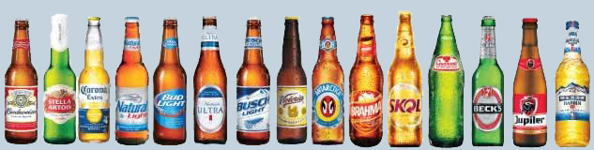
The Data
Breweries <- read.csv("C:/CaseStudy1/Breweries.csv", header = TRUE, sep = ",")
DataSet of 558 US Microbreweries
Beers <- read.csv("C:/CaseStudy1/Beers.csv", header = TRUE, sep = ",")
Dataset of 2410 US Craft Beers

Slide 4
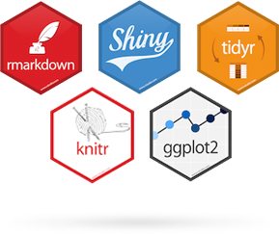

Analysis Tools for R-Studio
library(dplyr)
library(knitr)
library(rvest)
library(ggplot2)
library(psych)
library(maps)
library(plyr)

Slide 5
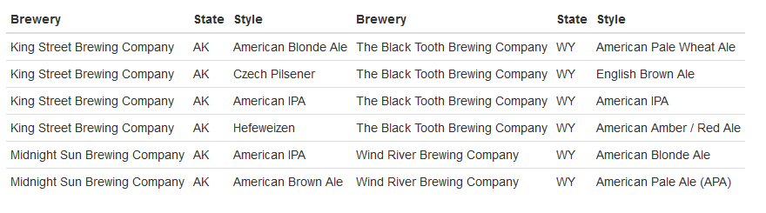




From Alaska to Wyoming A Revolution is Brewing
beers <- BeerData[c(1,3,5)]
Alaska <- head(beers,7)
P1 <- Alaska[2:7, ]
Wyoming <- tail(beers)
P2 <- Wyoming[1:6, ]
knitr::kable(list(P1, P2), row.names = FALSE)
Notes:
According to data from the Brewer’s Association the number of microbreweries in the US jumped from 620 in 2010 to 2,626 in 2015.
https://www.brewersassociation.org/statistics/number-of-breweries/

Slide 6
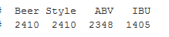
Data Driven Brewing
MicroBrewers are making complex and innovative beers.
All 2,410 beers had a specified style and type
97% of the beers had a specified ABV
58% of the beers had a specified IBU.
colSums(!is.na(BeerData[4:7]))

Slide 7
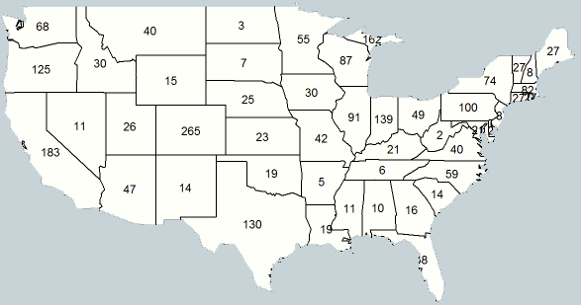
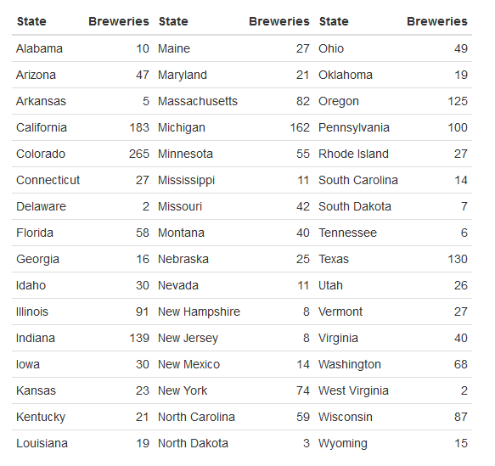
Breweries Per State
BreweryState <- count(dataset_merge,"State")
BreweryState <- BreweryState[-c(1,8,12), ]
BreweryState <- BreweryState[order(BreweryState$State), ]
States <- States[-c(2,11), ]
States <- States[order(States$State), ]
BreweryState$StateLong <- States$StateLong
BrewStateLst <- BreweryState[c(3,2)]
BrewStateLst <- BrewStateLst[order(BrewStateLst$StateLong), ]
colnames(BrewStateLst) <- c("State", "Breweries")
L1 <- BrewStateLst[1:16, ]
L2 <- BrewStateLst[17:32, ]
L3 <- BrewStateLst[33:48, ]
knitr::kable(list(L1, L2, L3), row.names = FALSE)

Slide 8
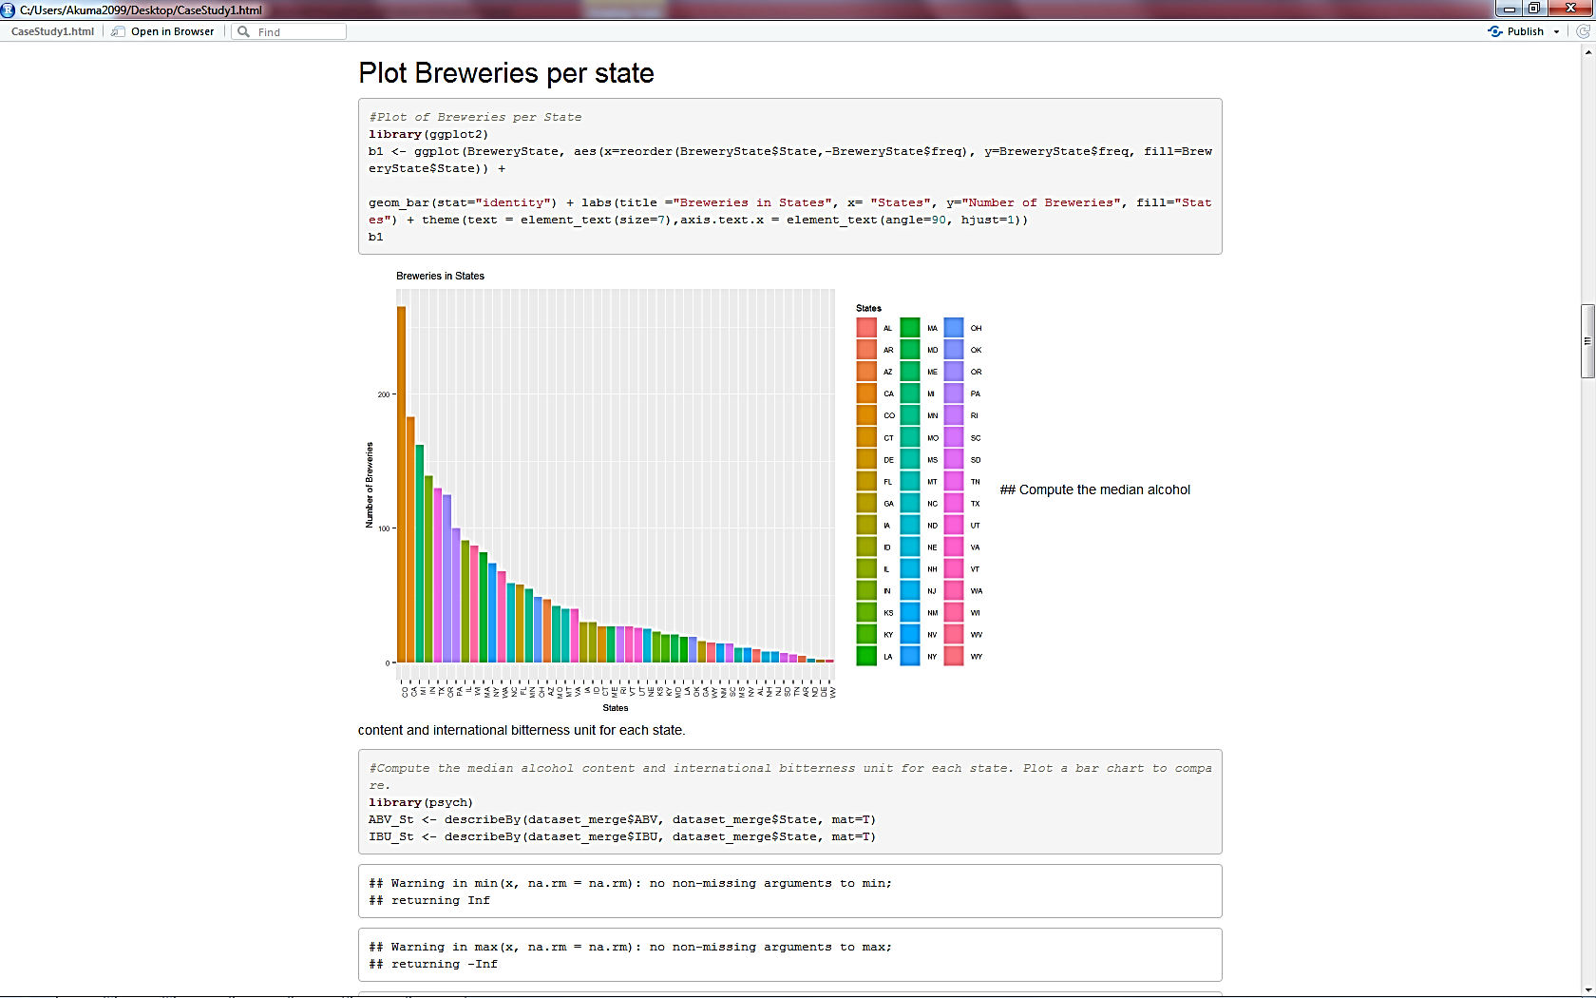
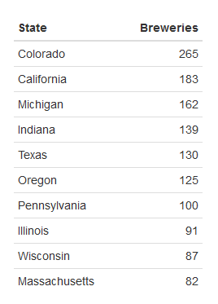
Breweries Per State
library(ggplot2)
b1 <- ggplot(BreweryState,
aes(x=reorder(BreweryState$State,- BreweryState$freq), y=BreweryState$freq, fill=BreweryState$State)) + geom_bar(stat="identity") + labs(title
="Breweries in States", x= "States", y="Number of Breweries", fill="States") + theme(text = element_text(size=7), axis.text.x = element_text(angle=90, hjust=1)) b1

